Slide 1



Docker & Containerization: Simplifying the Future of Software
Why Docker is the go-to tech for modern engineers!

Slide 2
What is Docker, Anyway?
Docker is like a virtual toolbox that packages apps with everything they need to run, anywhere!
Think of it as a "carry-on suitcase" for your code—no need to repack at every airport (or every server).

Slide 3
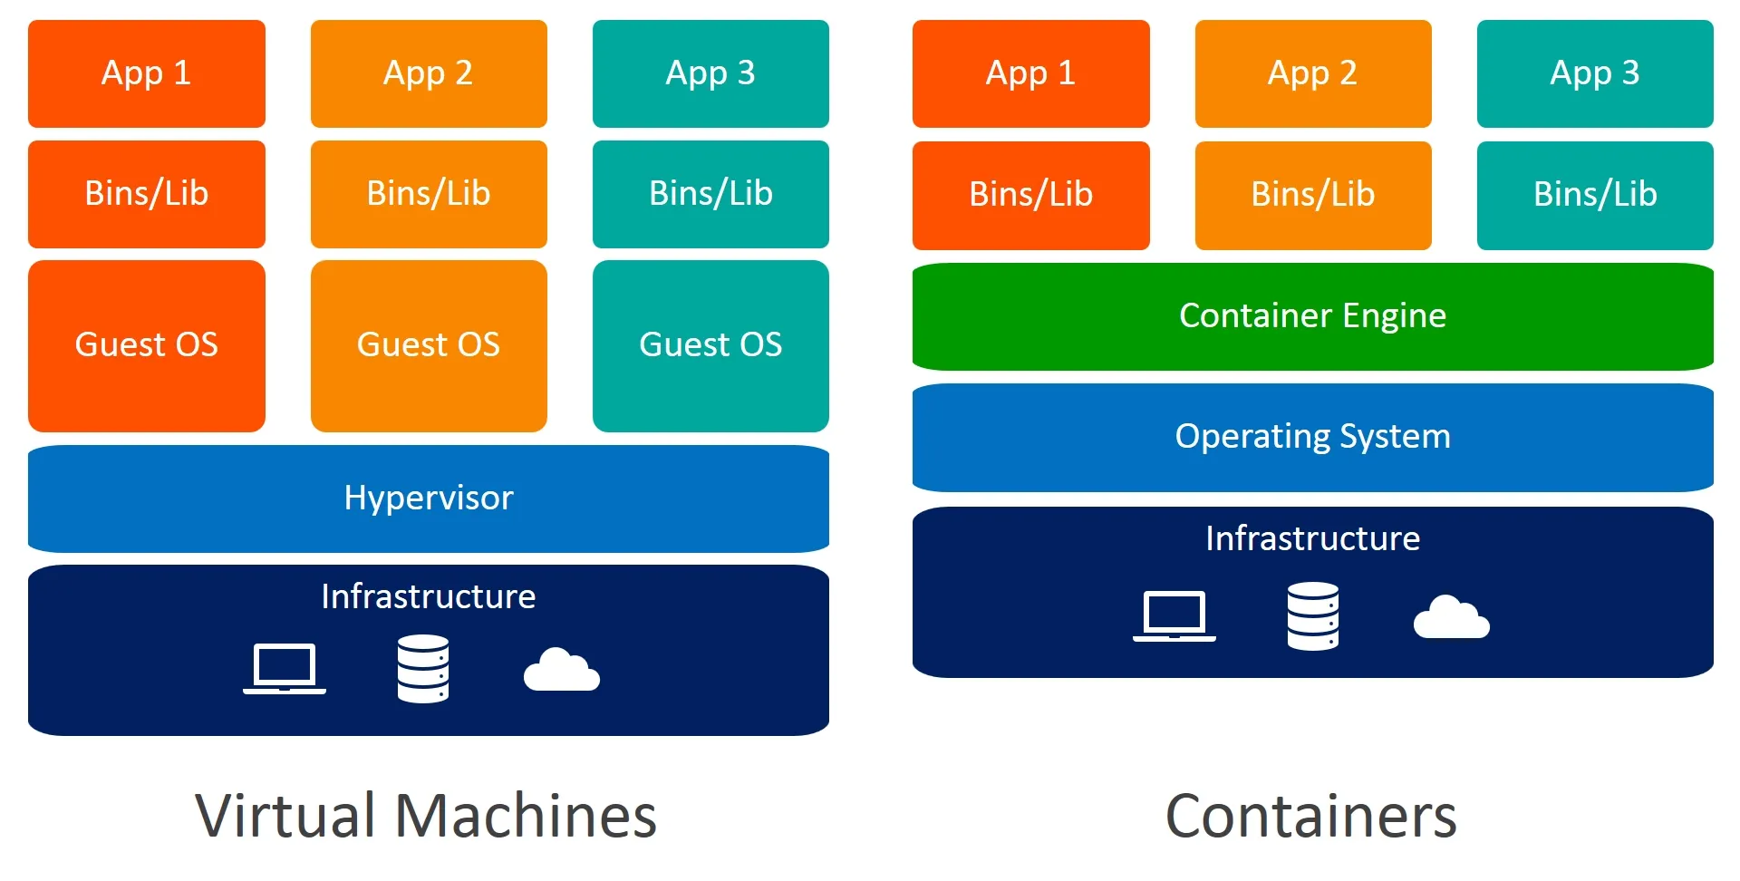
Containers vs. VMs: What's the Difference?
VMs: Heavy and bulky—like bringing an entire house when you travel.
Containers: Lightweight—like traveling with just your essentials!
Containers share the same operating system, making them faster and less resource-heavy.

Slide 4
Why Should You Care About Docker?
Instant setup: Run your app in seconds!
Works everywhere: Run your app on any system, no compatibility issues.
Collaboration: Share your containerized app with your team like a zip file.
Scalable: Easy to scale up for millions of users.

Slide 5
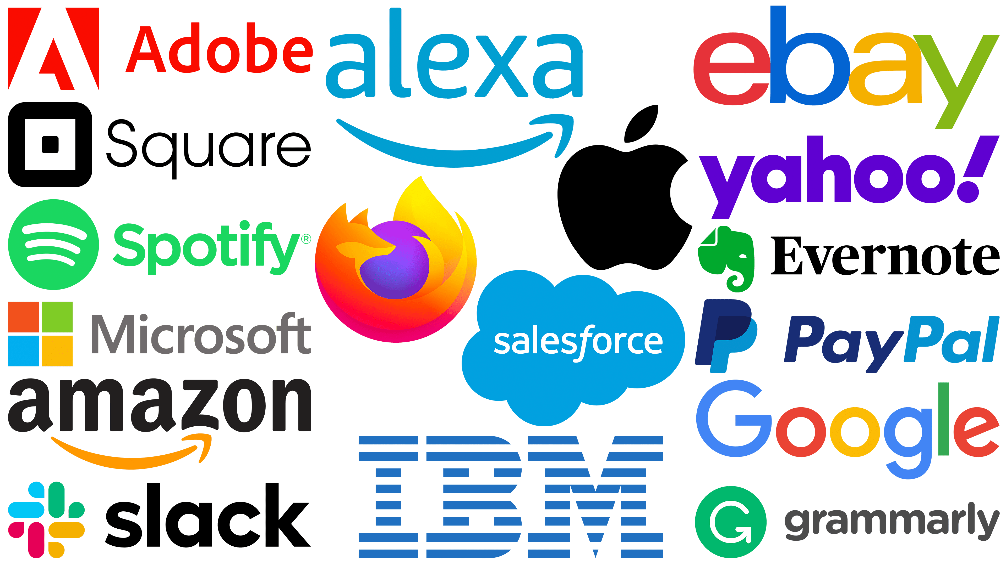
How Docker Powers Your Favorite Apps
Instagram, Spotify, Netflix all use Docker to deliver content smoothly.
Great for gaming apps, web services, and AI—anything where speed and efficiency are crucial.

Slide 6

Let’s Dockerize something!
You can download the slides and source code from my GitHub.
OR
https://github.com/KhaledELKarazle97/DockerDemo

